Slide 1
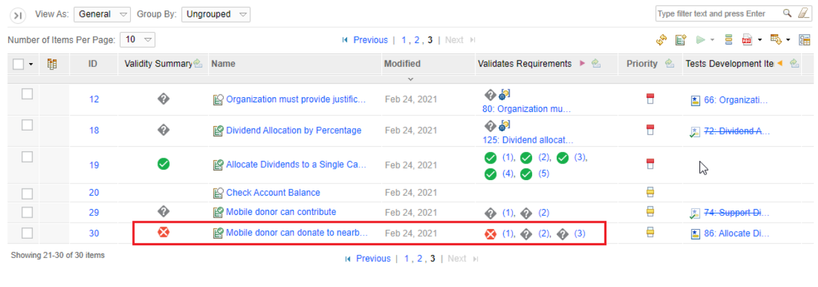
OSLC Specification for link validity
Eran Gery

Slide 2
Why standardizing link validity
“Linked data is only useful when semantic consistency exists between two artifacts and their relationship. In projects with large data sets, achieving and maintaining consistency across linked data can be challenging over time. You can use the link validity status to achieve consistency across artifacts and links as you make changes that propagate through linked data.” (IBM Jazz online documentation)
Currently OSLC does not provide any specification on how to establish and inquire validity of links

Slide 3
How link validity works
Link validity is specified wrt the source and target artifact contents represented by a content hash (#)
A link is identified by source#, target#, and linktype and the conceptURIs which are used for diagnostics and migration purposes and safeguarding uniqnes of the validity record
The artifact content hash is determined by the resource provider and can be based on a validity profile
RM Provider
RM Resource
ValidityStatus GetStatus (R1URI, R1#, R2URI, R2#, Linktype, profile)*
-> (R1URI, R2URI, Linktype, profile, ValidityStaus , comment, UID, time)*
RxURI is a concept URI
LVS returns the record with latest timestamp in
Case of multiple matches
Get should match R1,R2 or R2,R1 (order independent)
Get status is a bulk operation implemented using a post
3. GetContentHash(context, RsURI) -> contentHash
Link Validity Service
GetContentHash is a get on a
Concept resource with a special header
2. SetStatus (R1URI, R1#, R2URI, R2#, Linktype, ValidityStaus, profile, comment, UID, time)
-> success (200)/ (400)
Link Validity logical data model
verifies
Resource 1 # | Resource 2 # | Link Type URI | LinkValidity Profile | Validity Status
Valid, invalid, suspect
QM Resource
QM Provider

Slide 4
Link validity reporting
TRS feeds
Concept URI | Concept URI | Link type
Requires version resources content hashes to be fed to TRS
Should be the responsibility of the domain providers (e.g. DNG) to feed the mapping to TRS
Currently unclear, suspicion that ELM uses LVS to store this mapping
LVS trs feed
Reporting on LV is based on on conjuncting version URIs with content hash mappings and then with LVS feed
Example from ELM of finding the contentment (provided by Ernest)
?oslc_rm_Requirement1_contentHashVersion dcterms:isVersionOf ?oslc_rm_Requirement1_uri. ?oslc_rm_Requirement1_contentHashVersion ns_validity_:contentHash ?oslc_rm_Requirement1_contentHash.
Concept URI | Version URI
Version URI | Content#
Content# 1 | Content# 2 | Status

Slide 5
Show validity in RM use case
User opens a requirements collection view in RM
RM opens the view and displays a screenful set of requirements
RM needs to find inbound links to the requirements based on the view rows, so it calls LDM with the GCM context and list of displayed requirements
LDM returns a set of link triples <source-req, predicate, target-resource> and RM populates the view with the links, in addition to its outgoing links
RM performs a get for each target resource to display the name of the resource
RM needs to find the validity status of each link in the view. To do that,
RM fetches for every link target resource it’s content hash, by performing a sequence of get(#) operations on each target resource URIs
RM applies a bulk post to LVS with the content hashes and predicate for every link displayed <r1#, predicate, r2#>, to obtain back the link validity status {valid/suspect/invalid}
RM matches the response with each displayed link and presents the status
Note: can we unify the two gets to obtain both the name and content hash in one round

Slide 6
Link validity migration
How to recover LVS data after migration?
Content hashes will change
Need to map old content hashes to new content hashes
Migration should produce mapping tables
old URIs to New Uris (as part of link resolutions)
URI, old content#, new content #
LVS table should be corrected where oldURI, oldContent# entries are replaced with newURI, newContent#
This assumes URIs are in LVS
Probably requires storing version URIs in LVS

Slide 7
Comments on LVS related services
1 – get status: should allow a bulk operation for multiple links
2 – set status: a bulk operation necessary here? Probably not
3 – get hash: bulk may be useful but unclear on how to implement without pathmath

Slide 8
Issues with ELM current implementation
For some reason provide version URIs when interacting with LVS, that seems odd and unnecessary
Apply pathmath to obtain the hash from the resource provider
Instead should have a special header on the get of the resource

Slide 9
Link validity considerations
Relationship between LDM and link validity service (LVS)
Interaction patterns
Applications exchanging resource hash vs. LVS inquires resource hashes based on GCM

